Slide 1
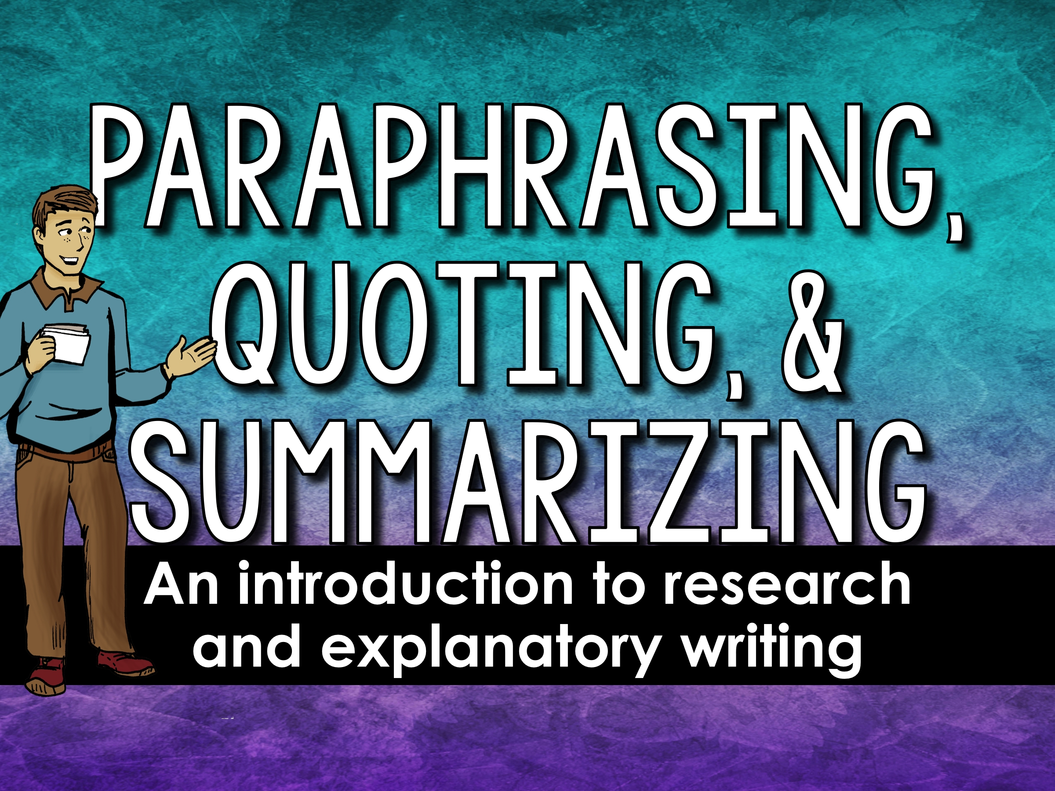

Slide 2
Paraphrasing, Quoting, Summarizing
Paraphrasing, quoting, and summarizing information is an important part of writing research papers and explanatory essays.
What is the difference between them?

Slide 3
Paraphrasing
Paraphrasing – When you paraphrase, you write a passage in your own words.
Paraphrased text is more detailed than a summary; paraphrased text is about the same length as the original text.
Paraphrased passages must be attributed to the original source.

Slide 4

Paraphrasing
When do I paraphrase?
You should paraphrase a source when you need a large section of original text in your writing, but you want to limit the the amount of direct quotes in your writing.

Slide 5
Quoting
Quoting – When you quote something, you use the writer’s original words (word for word) placing “quotation” marks around the quote.
Quotes must be attributed to the original source.

Slide 6
Quoting
When do I quote?
You should add quotes to your paper when paraphrasing or summarizing would take away from the original author’s intended.
Quotes should be meaningful and relevant, and help support your main ideas.

Slide 7
Summarizing
Summarizing – When you summarize, you write the main ideas in your own words. Summaries are shorter than the original text.
Summaries must be attributed to the original source.

Slide 8

Summarizing
When do I summarize?
You should summarize information for your paper when your audience needs to know the main ideas, but not all of the details

Slide 9
Why?
Why do we paraphrase, quote and summarize when we write?
Enhance our writing
Develop credibility (ethos)
Add depth to our writing
Provide relevant and supporting evidence
To avoid plagiarism accusations

Slide 10
Practice
Read the below Preamble to the US Constitution. In groups, paraphrase, quote, and summarize the text.
We, the people of the United States, in order to form a more perfect union, establish justice, insure domestic tranquility, provide for the common defense, promote the general welfare, and secure the blessings of liberty to ourselves and our posterity, do ordain and establish this Constitution for the United States of America.

Slide 11

How? – It’s as easy as ICE
How do you include a summary, quote, or paraphrase in your writing?
introduce the idea
cite the source
explain its relevance

Slide 12
Formatting Quotes
Quotes cannot stand alone! Use this formula for including direct quotes in your paper.
Transition + Indicator + Verb + Quote + Citation
For example, | Author name | writes, | “……..……..” | (page number)
For instance, | Character name | explains, | “……..……..” | (author,
To illustrate, | Subject name | argues, | “……..……..”
Moreover, | the author | states, | “……..……..”
Furthermore, | the character | says, | “……..……..”
*If you state the author’s name as the indicator, you only need to cite the page number.

Slide 13
Formatting Quotes
Can you label each part for the quote below?
Transition + Indicator + Verb + Quote + Citation
The novel Of Mice and Men by John Steinbeck begins in the picturesque Salinas Valley in central California. To illustrate, Steinbeck describes a river that “is lined with trees- willows fresh and green with every spring” (3).

Slide 14
Formatting Quotes
Can you label each part for the quote below?
Transition + Indicator + Verb + Quote + Citation
The novel Of Mice and Men by John Steinbeck begins in the picturesque Salinas Valley in central California. To illustrate, Steinbeck describes a river that “is lined with trees- willows fresh and green with every spring” (3).

Slide 15
Formatting Quotes
Can you label each part for the quote below?
Transition + Indicator + Verb + Quote + Citation
The novel Of Mice and Men by John Steinbeck begins in the picturesque Salinas Valley in central California. To illustrate, Steinbeck describes a river that “is lined with trees- willows fresh and green with every spring” (3).

Slide 16
Formatting Quotes
Can you label each part for the quote below?
Transition + Indicator + Verb + Quote + Citation
The novel Of Mice and Men by John Steinbeck begins in the picturesque Salinas Valley in central California. To illustrate, Steinbeck describes a river that “is lined with trees- willows fresh and green with every spring” (3).

Slide 17
Formatting Quotes
Can you label each part for the quote below?
Transition + Indicator + Verb + Quote + Citation
The novel Of Mice and Men by John Steinbeck begins in the picturesque Salinas Valley in central California. To illustrate, Steinbeck describes a river that “is lined with trees- willows fresh and green with every spring” (3).

Slide 18
Formatting Quotes
Can you label each part for the quote below?
Transition + Indicator + Verb + Quote + Citation
The novel Of Mice and Men by John Steinbeck begins in the picturesque Salinas Valley in central California. To illustrate, Steinbeck describes a river that “is lined with trees- willows fresh and green with every spring” (3).

Slide 19
Mix It Up
To add variety to your writing, include all three into your writing. Try to paraphrase, quote, and summarize in every body paragraph!

Slide 20
Quiz
When you paraphrase, you should be sure to… (select 2)
Write the text in your own words.
Place quotation marks around the text.
Properly cite the source.

Slide 21
Quiz
When you paraphrase, you should be sure to… (select 2)
Write the text in your own words.
Place quotation marks around the text.
Properly cite the source.
A and C are both correct! Do not place quotation marks around something you paraphrase, but you will need to write it in your own words and cite it.

Slide 22
Quiz
True or False: A summary should be the same length as the original text.
True
False

Slide 23
Quiz
True or False: A summary should be the same length as the original text.
True
False
B is correct! The answer is false. A summary is a shortened and condensed version, whereas when you paraphrase something, it will be similar in length to the original text.

Slide 24
Quiz
When should you use a direct quote?
When you need to provide a lot of details to your audience.
When you need to include specific or technical information in your text.

Slide 25
Quiz
When should you use a direct quote?
When you need to provide a lot of details to your audience.
When you need to include specific or technical information in your text.
B is correct! If you need a lot of details, you are better off paraphrasing. If you want specific or technical details, it is best to add a quote!

Slide 26
Quiz
What do you need to consider when adding in a direct quote?
How the quotation fits in grammatically with the rest of your text.
If the original author is still alive.

Slide 27
Quiz
What do you need to consider when adding in a direct quote?
How the quotation fits in grammatically with the rest of your text.
If the original author is still alive.
A is correct! When you include a quotation into your own paper, it needs to be grammatically aligned with the rest of your paper.

